Slide 1
Electronic Authorship
Collaboration, Appropriation, Community, and Practice
Scott Rettberg, University of Bergen

Slide 2
What’s Different about this world?
Some obvious aspects that are actually significant

Slide 3
Production
1) The process of production
2) The material produced
3) The destination of the process

Slide 4
Distribution
1) Social networks as distribution channels
2) Transnational by nature
3) Events, conferences, festivals
4) Unstable models based on institutions of print culture
5) No real division between digital art and e-lit culture

Slide 5
economics
1) Almost no investment from major print publishers in e-lit
2) Market forces have little impact on artistic production
3) For a period his has been to the benefit of experimental practice
4) As electronic reading device become commonplace, changes

Slide 6
Reception
1) The intimate community
2) Viral recommending, tweeting, blogging, "flagging"
3) Online journals, conventional media channels
4) Academic reception -- scholarly articles, collections, and monograph.
5) Teaching

Slide 7
“Canonization”
1) The problem of persistence
2) Archiving and documentation
- Anthologies
- Directories / Databases
- Archives / Repositories
3) Hacking the academic / industrial complex

Slide 8
Authorship

Slide 9
The Fiction of Solitude

Slide 10
Transparency of Collaboration in Digital media
Notes:
- Some collaboration is implicit in the choice of a particular tool, platform, programming language.

Slide 11
The spectrum of collaboration
Notes:
Range of models of collaboration
- Auteur
- Collaboration with stated roles (e.g. Writer, Designer, Developer, Filmmaker, Musician)
- Appropriation and Remix
- Author and known collaborators
(COLLECTIVE NARRATIVE MODEL)
- Author and authored system (e.g. generative work) / Procedural authorship
- Author and unknown authors or anonymous contributors
- wikinovel
- database narrative
- Author as information architect / visualizer

Slide 12
Feedback Loops
Author and coauthors
Author and responsive audience
Author and system
Author and the environment

Slide 13
Complications
Communication breakdown
Ownership?
Artistic choices
Notes:
- Roles break down
Example of complexity of defining author role in ELMCIP KB. What is the distinction between author and contributor?
Melding of roles in successful collaborations.
- Ownership
Insofar as authorship is largely an economic construct to begin with, various form of collaboration make ownership, copyright etc. more complex.
- Complicating artistic choices
Negotiating narrative
The tyranny of freedom (infinite choices available, all paths could be accommodated)
Forces working against interesting collaboration

Slide 14
collaborations in E-Lit
Some of my experiences

Slide 15
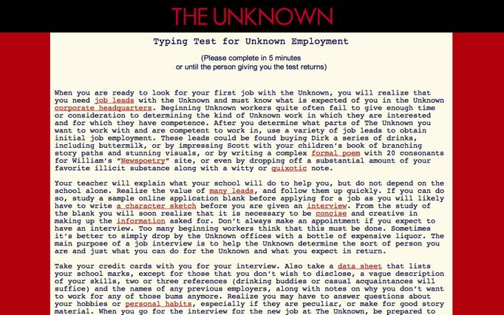
The Unknown (1999)
William Gillespie, Scott Rettberg, Dirk Stratton
Notes:
The Unknown
Collaboration: 3 main co-authors, number of invited guests
Collaborative models used:
1) "Jam sessions"
2) Language game with "moves"
3) Site and situation-specific writing sessions
4) Recontextualizing / linking
Appropriation: Homage, Overwriting, Identity Appropriation, Network Effects, Meta-Appropriation

Slide 16
The Meddlesome Passenger (2001)
Scott Rettberg
Illustrations by Shelley Jackson
Notes:
Metafiction originally written 5 years before web version. Role-defined collaboration with Shelly Jackson -- 3 sketches of the dead author awakening enraged. New layer of time-based paratexts (in a way this was more a current version of myself collaborating with an earlier one than it was rewriting).

Slide 17
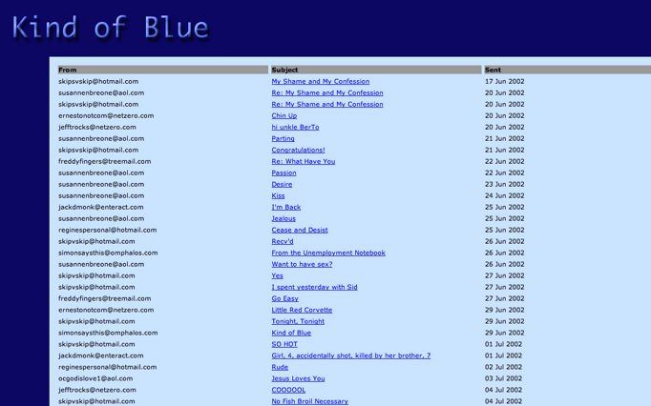
Kind of Blue (2002)
Scott Rettberg
After “Blue Company” by Rob Wittig
Notes:
Kind of Blue is an email novel written in response to another email novel, Blue Company by Rob Wittig. Kind of Blue was explicitly appropriative, in that the characters and some of the themes of Blue Company were taken directly from the prior novel. The context and situation was changed radically however. While Wittig's novel was about a group of corporate workers who had been transported in space and time to 14th century Italy, in Kind of Blue the same set of characters never left 2002 America though the focal character, Berto Alto, had been experiencing increasingly dangerous schizophrenic delusions which ultimately led to his institutionalization. Collaboration in this work was primarily appropriative, though the final message was co-authored with Wittig.

Slide 18
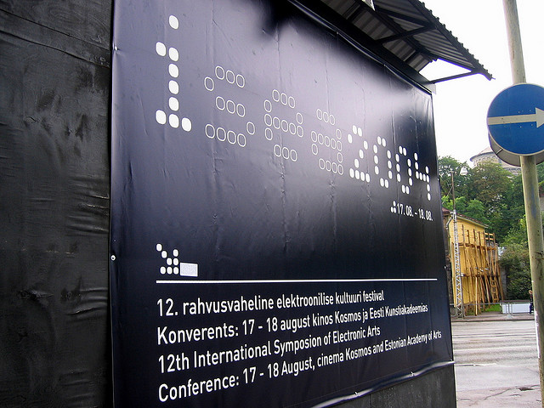
Implementation (2004) (2011)
Nick Montfort, Scott Rettberg
Notes:
Implementation is a sticker novel coauthored with Nick Montfort in 2004. The novel consists of 240 short narratives. Each of 8 serially released installments consists of 30 individual texts printed on 3 sheets of stickers. Participant readers then adhered the stickers wherever they chose, contextualizing that sticker in the physical world. Many readers then photographed the sticker placements, and emailed those photos back to us. In 2009 we reissued a call for photographs of Implementation, and in 2011 are releasing a book of the entire novel, with a photograph of each sticker. The result will be a kind of coffee-table novel of photographs of Implementation narratives framed by their physical placement in the world.

Slide 19
Tokyo Garage (2009)
Scott Rettberg
Overwriting of “Taroko Gorge” by Nick Montfort
Notes:
Tokyo Garage is poetry generator based on Nick Montfort's poetry generator Taroko Gorge. While Montfort's poetry generator, composed in javascript, results in the production of a flowing minimalist nature poem about a gorge natural park in Taiwan, Tokyo Garage generates maximalists compositions about Tokyo as urbanist fantasy. In modifying and overwriting the piece, I changed the code of Montfort's generator only minimally but the arrays from which the lines are built were replaced completely with a new and more extensive vocabulary. The act of appropriation was subsequently repeated by J.R. Carpenter in her piece "Gorge" -- which produces poems about eating and the body, and by Talan Memmott in his "Toy Garbage" -- which produces poems about amusements and detritus.

Slide 20
The Last Volcano (2010)
Roderick Coover, Scott Rettberg
Notes:
The Last Volcano (2010), and two pieces in progress -- Cats and Rats, and Norwegian Tsunami are short films produced by Roderick Coover. I'm collaborating in producing the writing of these films. As we work through the pieces, Rod is providing me with images. We talked through and agreed to a general frame for the trilogy, and each piece is to some extent about cross-cultural communication as much as it is about how disasters are processed and received, remembered or forgotten. Rod reacts to the texts that I send him, suggesting revisions. Jill Walker Rettberg and others have also worked on finessing or translating the Norwegian portion of the texts. He times out the dialog by laying a subtitles track, and we adjust the narrative again to fit our idea of how long the short film should be. The actors reading the bilingual translations have also modified and interpreted portions of the texts. Rod and I work with the readers during the recording sessions, and have changed the narrative to some extent on the way that the piece sounds in actual voice. Rod then produces the finished film. Although these are small-scale endeavors, the experience is giving me some sense of the collaborative nature of film-making. Although the strongest input, or the decisive one, is that of the film-maker, the investment in the creative act is shared, and the film is much more explicitly a product of social interaction than many other types of writing I have done. Although we began the project together in person, the second two films are being produced remotely. The soundtrack for the second film was done via a Skype recording session split between Bergen, Duluth, and Philadelphia.

Slide 21
Insights?

Slide 22
Network - Enabled
Notes:
The first is that regardless of content, the processes of creative collaboration are more easily enabled by the network. Technologies as simple as skype, email, and file sharing make it almost as simple to collaborate with someone on a different continent as it would be to collaborate with someone down the hall.

Slide 23
The Joy of Meatspace
Notes:
Having said that, I think that without periodic colocation, the collaborative process is difficult both to begin and to maintain. A six or seven hour time difference, for instance, can complicate one's ability to swap ideas and work on projects.

Slide 24
Adversarial and Dialogic
Notes:
Collaboration can, and probably should, be productively adversarial. If everyone collaborating on a project agrees which direction it should be headed and how to get there, there is a loss of a dialogic dimension from which the surprises that collaboration most fruitfully engenders emerge.

Slide 25
Game
Notes:
In almost every case, I have experienced collaborating as a kind of game, albeit one without quantifiable outcome, winners or losers. In the case of the Unknown, the game was played using characters pseudonymous to the authors, and our moves consisted of writing each other's characters in and out of specific comic situations.

Slide 26
Collaboration And/or ApPropriation
Notes:
The boundary between collaboration and appopropration is porous. I never explicitly asked Nick Montfort if I could borrow the codebase for Taroko Gorge, though I was pretty confident he would appreciate the fact that I upgraded his poetry generator, and surprised him with an email directing him to the new work.

Slide 27
Collaborating with the machine
Notes:
Collaboration in digital environments is not limited to the interaction of human cognizers. The systems we engage with and the network environment are not actively conscious in any discrete way, but they provide for a different type of recursivity. In creating generative poetry and narrative projects, my process feels very much like collaborating with a machine. I spend hours with each generative project watching and tweaking the program as it processes and outputs text. In spite of the fact that I may have written a program, it is able to surprise me, and I react to it in a feedback loop that feels quite similar to interacting with another conscious agent.

Slide 28
Constraints
Notes:
Constraints have proven useful in a number of the collaborations I have been involved. That is, if we are working without a map in the sense of sharing an idea of how a given narrative might progress, who the characters might be, etc. we can agree to certain rules and procedures. Regardless of their relation to the content of the given work itself, these constraints help to structure the writing progress. These rules can be quite simple and even arbitraty and still prove quite useful for lending the text a certain scaffolding as it takes shapes, or even by simply removing certain questions from debate. For instance, in writing Implementation, Nick and I knew that each sticker had to fit on a business size shipping label. This equated roughly to one 3x5" notecard of handwritten text. It didn't matter whether or not a particular aspect of the narrative could benefit from exposition longer than that. It need to fit the card. If constraints do not provide all of the actors working on a project with a common "script" they do offer some common if arbitrary guidelines, a sense that the chaos is at least somewhat contained by agreed conventions.

Slide 29
Friendship
Notes:
A word about the milieu of collaboration: I'm interested in experiences that others have had with people who they did not know, but in my experience, collaboration has been a product of friendship, of relationships that are built over years. Making art is one of the things that I do with many of my best friends. And at its best, friendship produces a level of trust that I think necessary to be honest and critical enough to produce compelling art together. And because these collaborations are built on friendships, they have led me down paths I would have otherwise not explored. I would likely have never become interested in developing narrative generators, or writing scripts for films based on panoramic photography and video art, were it not for friends inviting me over for jam session.

Slide 30
Collective Narratives
Recent works exploring larger scale collaboration

Slide 31
TOC: A New-Media Novel (2009)
Steve Tomasula, Stephen Farell, et al.
Notes:
TOC by Steve Tomasula
TOC: a new media novel (2009) by Steve Tomasula (author) and Stephen Farrell (creative director and designer). The work is published on DVD for playback on Mac or PC by the University of Alabama Press under the FC2 imprint. Tomasula and Farrell are well known for their work together on VAS: an opera in Flatland, a 2004 novel about a Square’s decision to have a vasectomy and its impact on his a tidy geometric family. VAS won a number of major design awards and was acclaimed for Tomasula’s peculiarly innovative writing style, its broad imaginative sweep into genetics, representations of the body, and identity, and in particular for its amazing design, which pushes the limits of how print typography, layout and imagery can affect the way that a story is received and interpreted. In TOC, which Farrell and Tomasula worked on together from 2003-2008, we see what can be accomplished in new media when an innovative fiction writer collaborates intensively with a brilliant visual designer.
Although it is described as novel, readers looking for a conventional linear narrative experience will find themselves at sea in the storyworld of TOC. The publishers describe the work as “An evocative fairytale with a steampunk heart . . . a visual novel, a myth woven from text, film, music, photography, the spoken word, animation, and painting.” The various materials of TOC are bound together by a thematic focus on the relationship of human psychology to time and by Tomasula’s intensely concentrated narrative voice and drily humorous but engaged and affective style. The individual units of stories presented to the reader work much more like Kafka’s parables than they do like chapters in a conventional novel. There are also several different sets of animations, including one running thirty minutes, each of which are narratives in their own right.
TOC is a sort of gesamtkunstwerk in that every aspect of the work, ranging from Tomasula’s texts, to Farrel’s design, to the animations designed by Matt Lavoy and Christian Jara, to Maria Tomasula’s lavish surrealist paintings that illustrate part of the text and the soundtrack including original music by a number of contributors, is beautifully produced and well integrated into the whole. All told some fifteen different artists contributed in some way to the production of TOC and the energy, time and attention devoted to the project shows in the finished project.
TOC indicates one direction collaborative new media writing projects might take in the future. Here we see a sort of film studio model in minature, in that each producer's role in the project, from author, to creative director, to illustrator, to musician, is distinct from the other. The author and the creative director are orchestrating something akin to a new media opera.
There are advantages to this approach -- perhaps by having a large team together and dividing roles explicitly, each artist is able to play more clearly to his or her strentghs. The novelist can focus more explicity on the writing, the painter on the illustrations, the composer on the music, the animator on the motion graphics, etc. And perhaps as tablet computing takes off and publishers and digital entertainment studios become more interested in the potentialities of interactive books, this mode of collaboration will become more common. At present however this scale of undertaking would be difficult for most e-lit authors, who tend to collaborate more on the scale of a garage band than a symphony.

Slide 32
Exquisite Code (2009)
Brendan Howell, et al.
Notes:
performance system for heterogeneous groups of writers." The project has had iterations in Berlin, London, and Bergen, each working according to different rules of operation. In the London version, eight writers were employed for five days at contributing to the development of a "collective novel." The writers each proposed prompts for individual writing sessions. A program arbitrarily selected prompts from that pool. Once the writers completed a session, the program then selected and mangled the texts, "worming through" them according to a variable selection of editing algorithms. The mangled texts were then displayed to the writers, who generated new prompts inspired by that set of texts. Simultanelous to the novel writing, the code of the editing software was "interrogaged and re-written in scheduled code writing sprints."
After 5 days of this interactive, collaborative, and to somewhat de-humanizing or at lease "de-authorizing" set of writing behaviors, the resulting "exquisite code life novel" resulted, which was later published as a print book including the text of the novel and the source code of the program used to mangle and edit it.
From the standpoint of collaboration, the most interesting aspect of this project is the fact that it explicitly positions the human writers as procedural nodes of a process, essentially no different from other routines in the program. Hierarchy is almost completely flattened in this way. Neither the work of the programmers, nor the work of the writers, nor the code itself, was more or less determinative in the output, but equally weighed aspects of a process.
The result, of course, could not equated to a singularly authored novel, or even a collectively written one designed to be read as a coherent entity. That's not to say that it is unreadable. Clear themes, characters, and situations emerge from its mass, and much of writing is quite good. But ultimately the novel, the book as artifact, is more a documentation of a procedural performance than it is a holistic narrative.

Slide 33
The Last Performance (2007)
Judd Morrissey, Mark Jeffery, et al.
Notes:
Judd Morrissey, Mark Jeffrey, Goat Island, and 145+ additional people contributed to The Last Performance (dot org) (2007). The project’s creators describe it as “a constraint-based collaborative writing, archiving and text-visualization project responding to the theme of lastness in relation to architectural forms, acts of building, a final performance, and the interruption (that becomes the promise) of community.” The project is a kind of hopeful monster, a mutated form of literature that combines elements of dance and performance, information and physical architecture, and Oulipian constraint-driven approaches to writing. The visual presentation of the project is based on the structure and details of the Dzamija, a mosque built on top of an old church in Zagreb, Croatia. Elements of the structure were derived from a dance performance by Goat Island, a Chicago-based performance collective. The organizational principles of the text are largely algorithmic. The individual texts themselves are written in response to a series of odd, seemingly arbitrary constraints such as “Construct a last performance in the form of a heavy foot that weighs two tons and remains in good condition.” The texts that form the material basis of the project are contributed both by the authors who have been working most closely on the project for two years and by readers who stumble across it on the Web and decide to contribute a text by responding to a constraint or to one of the other texts.
From the perspective of collaboration, some of the distinctive features of the Last Performance are that the collaboration crossed not only roles but disciplines and even art forms. The constraints that inform the writing of the project actually originated as performance constraints for time and movement-based performance art. The database narrative is in part a response and companion to the performance, though the two became intertwined over time. The project has further been instantiated in multiple modalities: as it is experienced online, in performance, where the projected and read work is joined with movement and dance, as an installation suitable for an art gallery or museum, and even as a film. In the database element, individual segments of contributed text can be read in isolation, as individual narratives, but they are also processed and visualized via algorithmic processes, becoming part of the text-as-a-whole and aspects of a text as visual artwork. Authorship here is distributed, between the authors of the constraints, Morrissey as the programmer and information architect, the authors of all the individual texts, and the system that is processing and interpreting the texts-as-data.

