Slide 1
Academy as Network
Greg Niemeyer, Artist, UC Berkeley
Co-founder, Berkeley Center for New Media

Slide 2
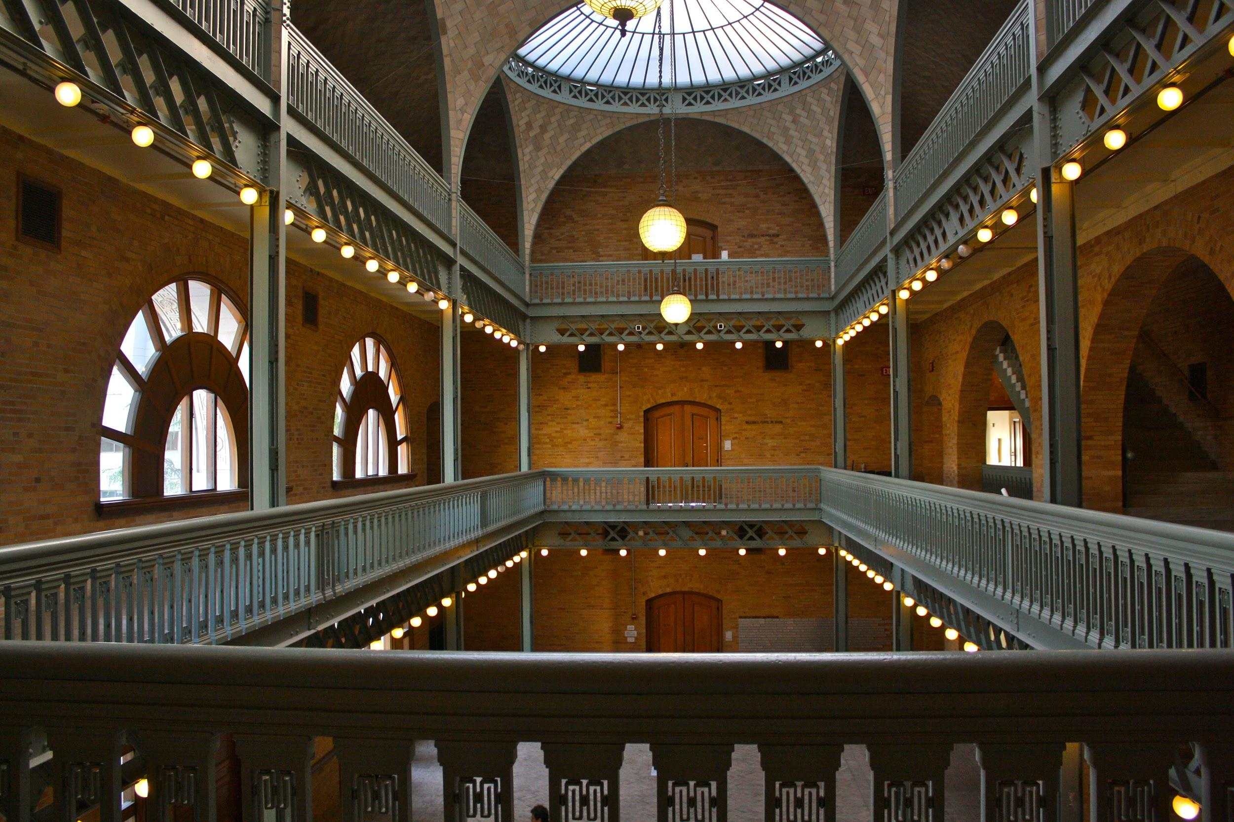
Institutional Blindness
William Randolph Hearst has "lessend no man's store"

Slide 3
Food
Why I am here now.
Scott
Rettberg
University of Bergen
BCNM
Greg
Niemeyer
Director
Alex Saum Pascual
eLit
Norway
New Media
Spanish
UC Berkeley
PederSather
Sather
Grant

Slide 4
Edges and Nodes
World
Within:History
Beyond: Technology
Community
Within:History
Body
Beyond: Technology
Within:History
Beyond: Technology
Self

Slide 5
Food
Why I am here now.
Scott
Rettberg
University of Bergen
BCNM
Greg
Niemeyer
Director
Alex Saum Pascual
eLit
Norway
New Media
Spanish
UC Berkeley
PederSather
Sather
Grant

Slide 6
Food
What I can say.
Scott
Rettberg
University of Bergen
BCNM
Greg
Niemeyer
Director
Alex Saum Pascual
eLit
Norway
New Media
Spanish
UC Berkeley
PederSather
Sather
Grant

Slide 7
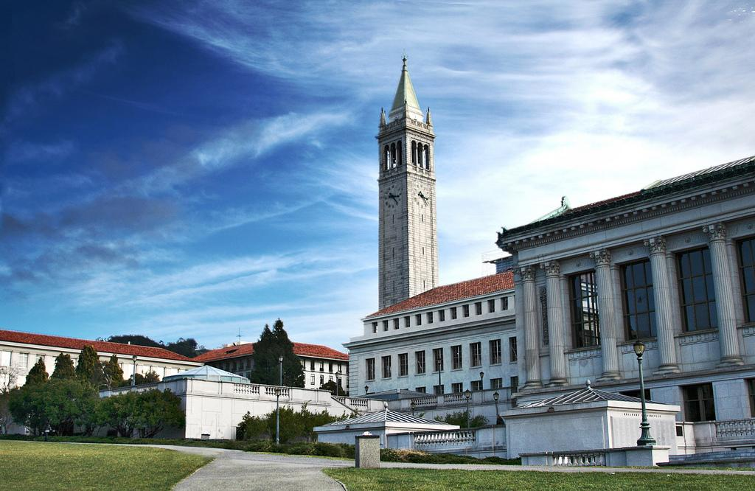
UC Berkeley
The Central Perspective

Slide 8
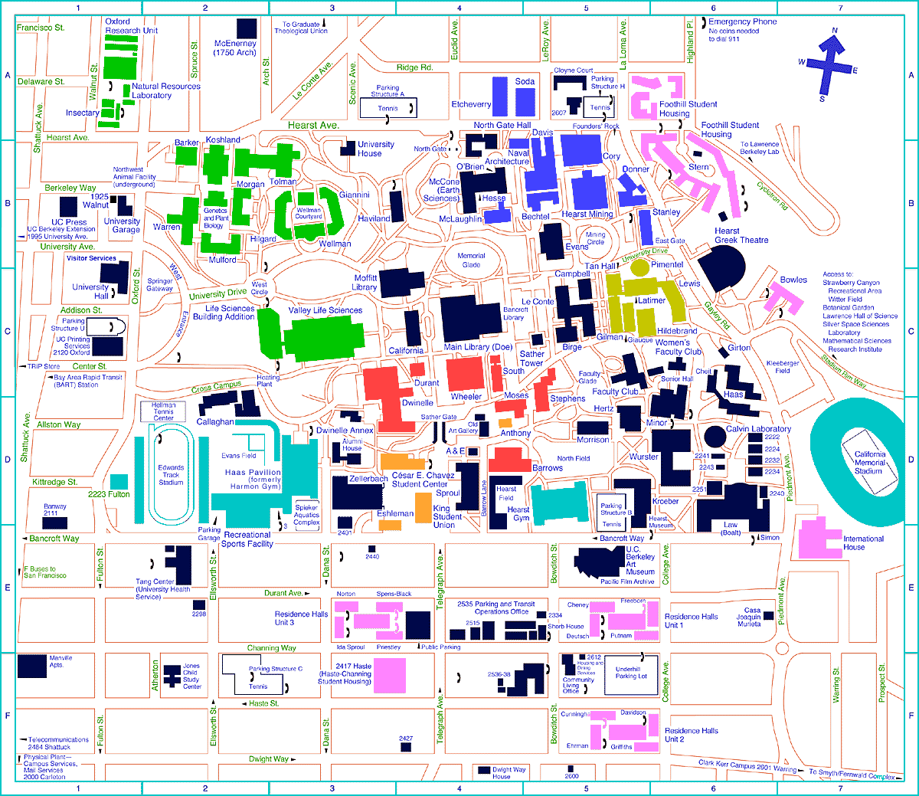
UC Berkeley
The Satellite Perspective

Slide 9
Foods
Hiking
UC Berkeley
Machines
Music
The Network perspective offers much potential,
if we can figure out who tends to the edges.
There are edge figures in each department.
There are unrealized potentials in each department.
There are.
Biologies
Maths
Transport
Cultures
Arts
Sports
Family
Housing
Housing
Music, People,
Candy

Slide 10
Food
Onwards to Media
Scott
Rettberg
University of Bergen
BCNM
Greg
Niemeyer
Director
Alex Saum Pascual
eLit
Norway
New Media
Spanish
UC Berkeley
PederSather
Sather
Grant

Slide 11
New Media is Media Innovation
New Media
Cultural impact of new media on human experiences
Physical and physiological impact of new media
Data culture, empowerment vs. disemancipation
Network aesthetics, network perspective
Ethical and moral issues (drones, bioengineering, privacy)
New media literacy (civic culture, SOPA, PIPA)
Media innovation (Tools over content)
Dissemination through practice, publication and education
Fabrication methods (makerspace)
Logic and the incompu (Parisi)

Slide 12
Food
BCNM structure
Scott
Rettberg
University of Bergen
BCNM
Greg
Niemeyer
Director
Alex Saum Pascual
eLit
Norway
New Media
Spanish
UC Berkeley
PederSather
Sather
Grant

Slide 13
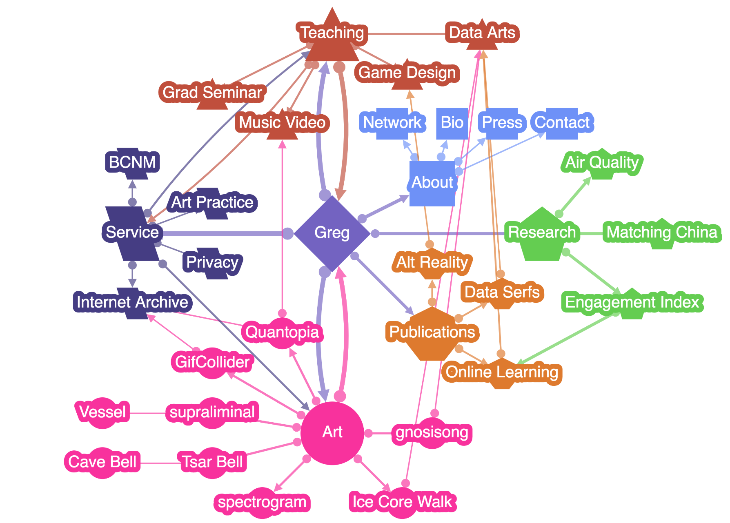
gregniemeyer.com

Slide 14
Food
Onwards to me
Scott
Rettberg
University of Bergen
BCNM
Greg
Niemeyer
Director
Alex Saum Pascual
eLit
Norway
New Media
Spanish
UC Berkeley
PederSather
Sather
Grant

Slide 15
Lark Buckingham, MFA, BCNM 2016

Slide 16
Berkeley Center for New Media
BCNM
Founded 2006
Name: Should be Media Innovation Network, but that sounds mean.
Budget: $200,000 per year, funded by central administration
Faculty: 3 faculty at 50%
Staff: 1 Executive at 80%, 1 Director at 25%
Degree: Extension of Ph.D. program called "Designated Emphasis in New Media" and extension of Masters program called "Certificate in New Media"
Courses:
4 core courses and 4 optional courses
about 2 summer courses
Lecture Series:
Art, Technology and Culture,
History and Theory of New Media
Exhibits and Conferences: 2-3 per year
Grants: Faculty grants around $25,000 per year, Student grants about $50,000 per year.
Advisory Board: Restructuring...

Slide 17
The Edges are functionally different from the Nodes:
No Boundaries
No Judgement
No Hierarchy
No Ownership
No Control
Yes Engagement
Yes Validation
Yes Participation
Yes Inclusion
Yes Experimentation
BCNM is an edge, but looks like a node.
Machines
CS, EE, Information
Industry
Biology
Math
Rhetoric, Spanish,
Humanities
BCNM
Art, Design, Architecture
Service
Music
Social

Slide 18
BCNM Governance
BCNM
Not attached to any school because that would overfit its mission
Executive board makes all decisions
BCNM faculty, director, and about 10 faculty and student volunteers are board members
Weekly meetings keep discourse alive
Constant social gatherings after lectures and events
Annual report to central campus administration
Pressure to fall into administrative order: possible administrative homes include new Division of Data Science, and possible Department of Media Studies
Intense web promotion of faculty and student works and outcomes
Metric: per capita cost of students served with a degree: 100000/30 = $3,333.33
Metric: per capita cost of audience reached with programming: 100000/5000 = $20.00
Metric: placement of graduates in academic careers: almost 100%

Slide 19
Methods (Personal)
Perception, Analysis, Intention, Action
Facilitation: Convener, Exhibitor, Host, Funder
Fueler of Connectivity
Initiation, Follow-through, Presentation and Reflection

Slide 20
Methods (Institutional)
In(ter)disciplinarity
Aggregation
Collaboration
Due Process
Organization
Fundraising
Structure
Routine
Support

Slide 21
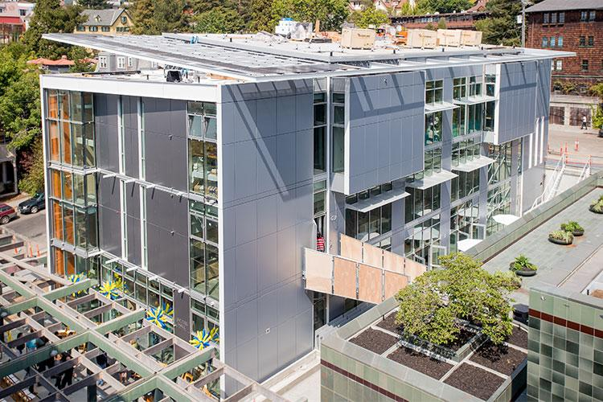
Outputs
Conferences and Events
Hackathons
Applications
Validation
Degrees
Scholarships
Awards and grants
Social capital
New organizations (Invention Lab, Jacobs, Data Science)
Patents
Startups
Products
Journals, books, software, hardware
White papers
Sponsored research

Slide 22
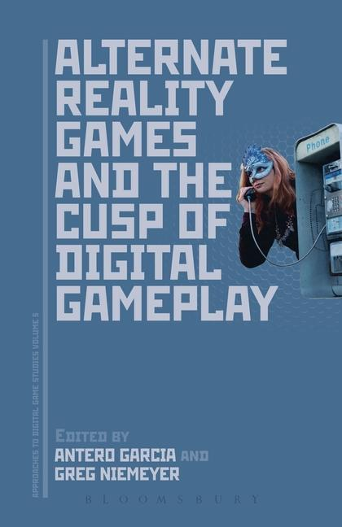
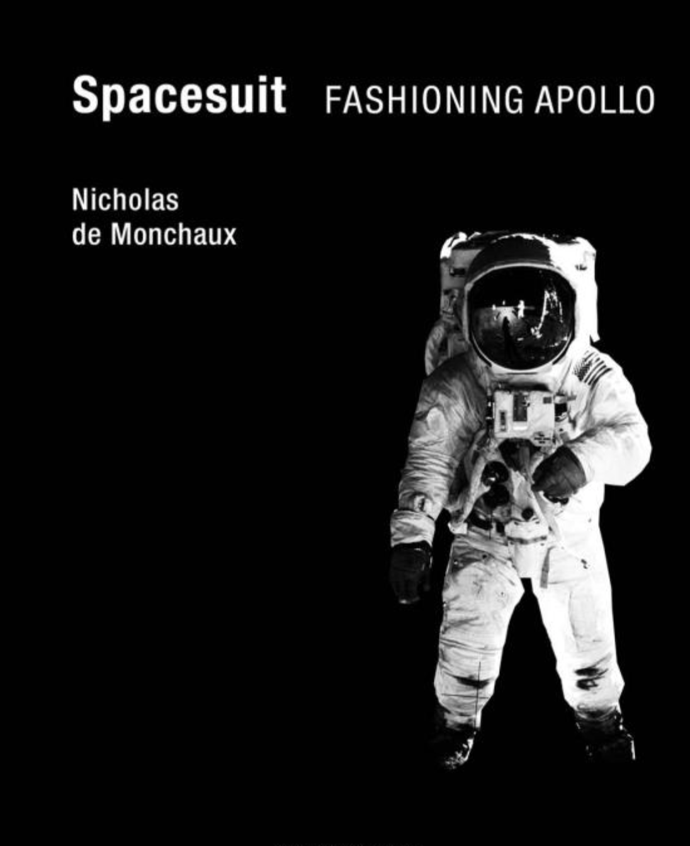
Notes:
Aclima Air Quality, Axent Headphones
100's of papers per year
about 4 published books per year
about 4 dissertations per year

Slide 23
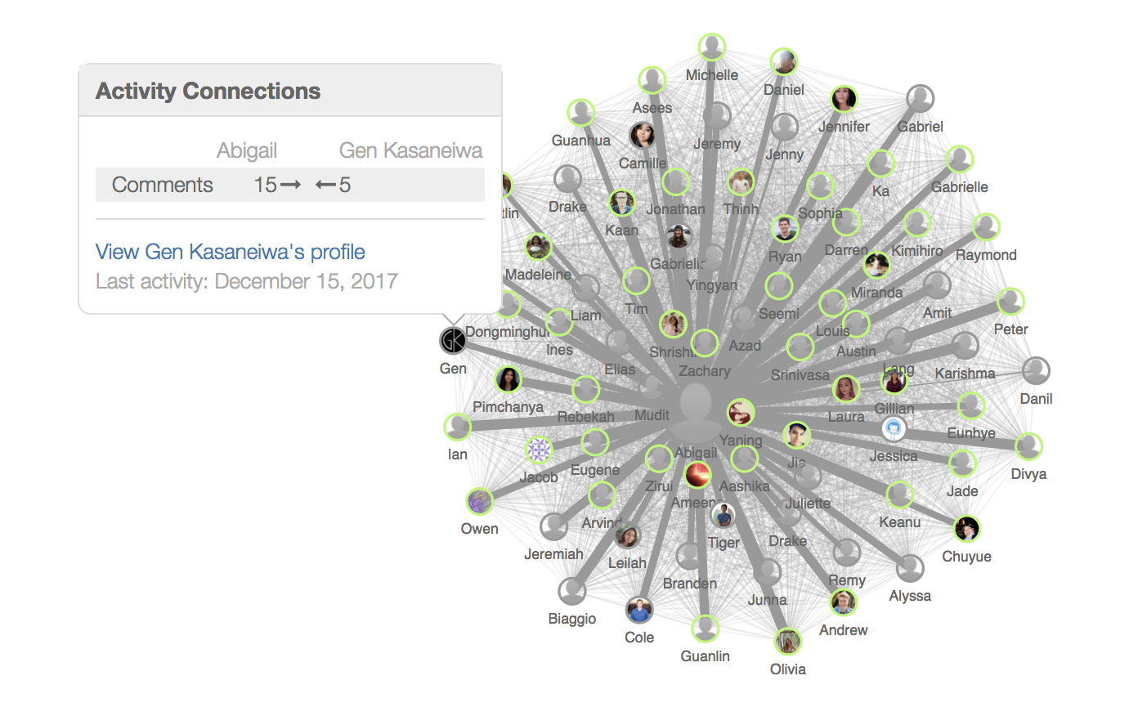
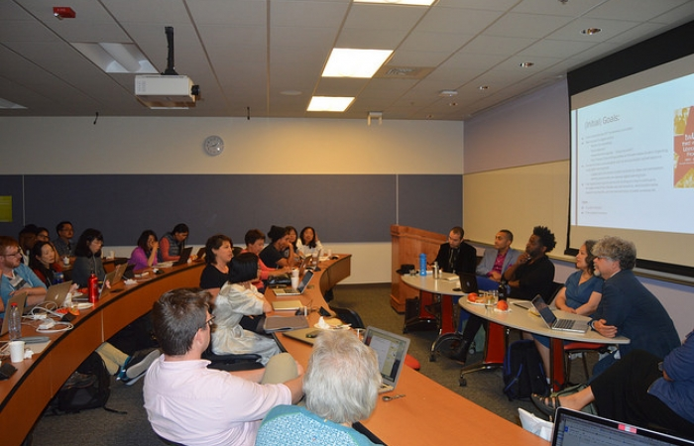
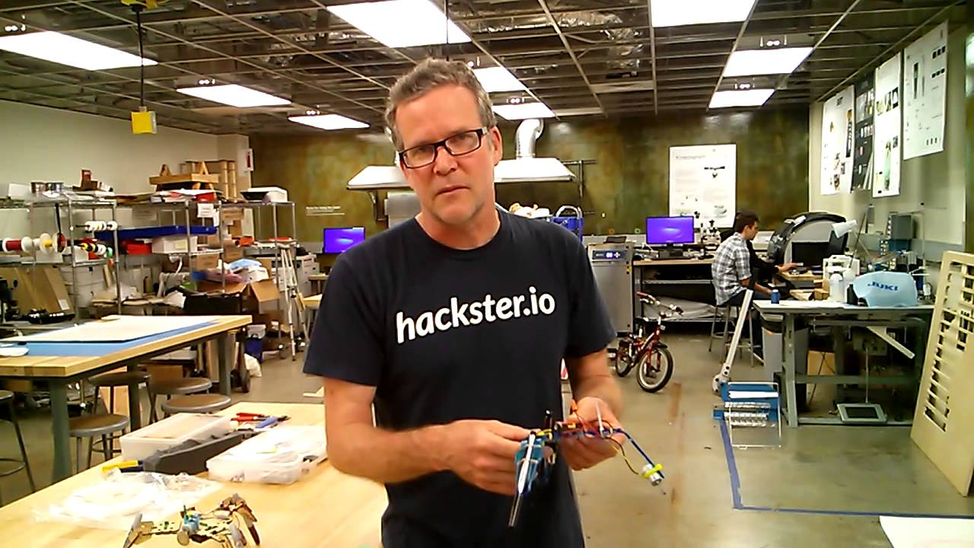
Notes:
Aclima Air Quality, Axent Headphones
100's of papers per year
about 4 published books per year
about 4 dissertations per year

Slide 24
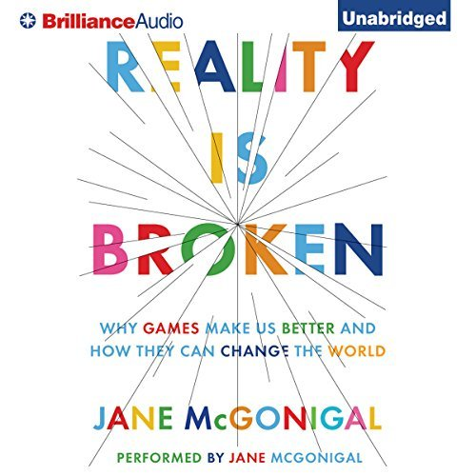
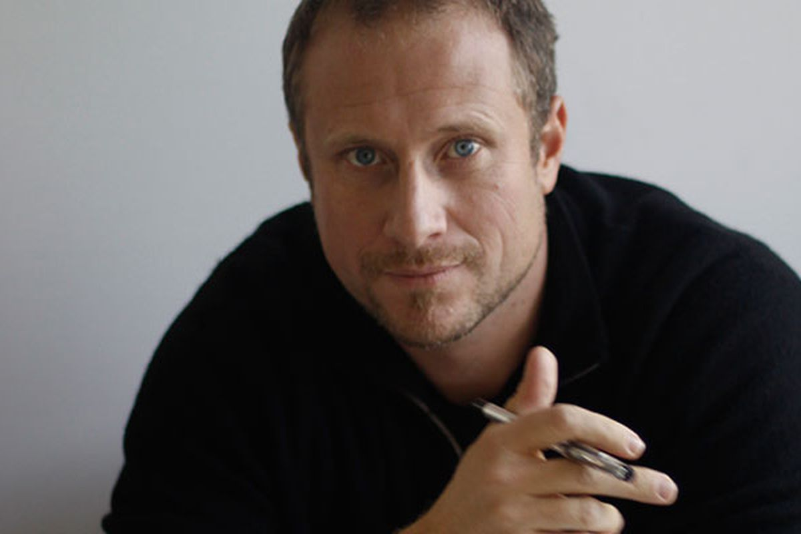
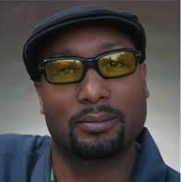
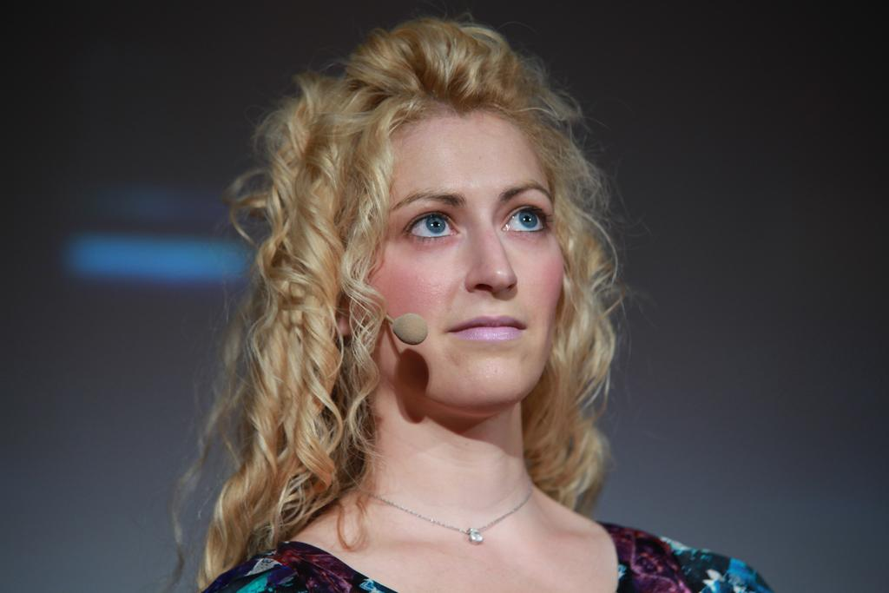
Notes:
all famous alumni are fiercely interdisciplinary

